Slide 1
Logistic Regression
Marlabs

Slide 2
Logistic Regression
Logistic Regression is a classification algorithm. It is used to predict a binary outcome (1 / 0, Yes / No, True / False) given a set of independent variables.
logistic regression as a special case of linear regression when the outcome variable is categorical, where we are using log of odds as dependent variable.
In simple words, it predicts the probability of occurrence of an event by fitting data to a logit function.

Slide 3
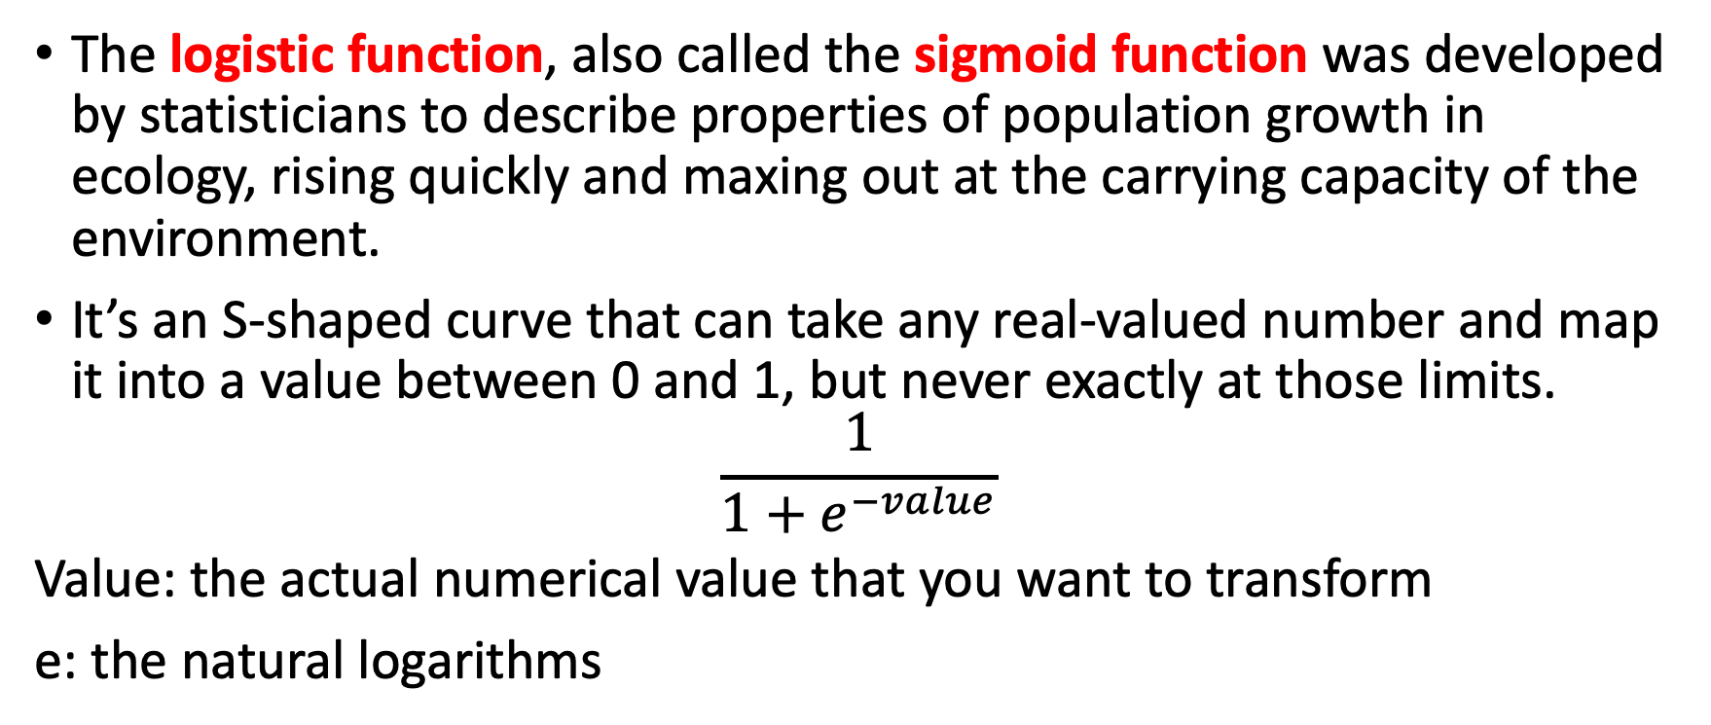
Logistic Function
The logistic function, also called the sigmoid function was developed by statisticians to describe properties of population growth in ecology, rising quickly and maxing out at the carrying capacity of the environment.
It’s an S-shaped curve that can take any real-valued number and map it into a value between 0 and 1, but never exactly at those limits.
$$\frac{1}{1+e^{−value}}$$
Value: the actual numerical value that you want to transform
e: the natural logarithms

Slide 4
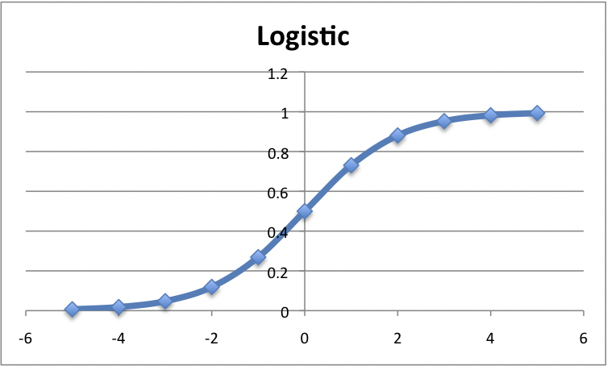
Logistic Function
Logistic Function

Slide 5
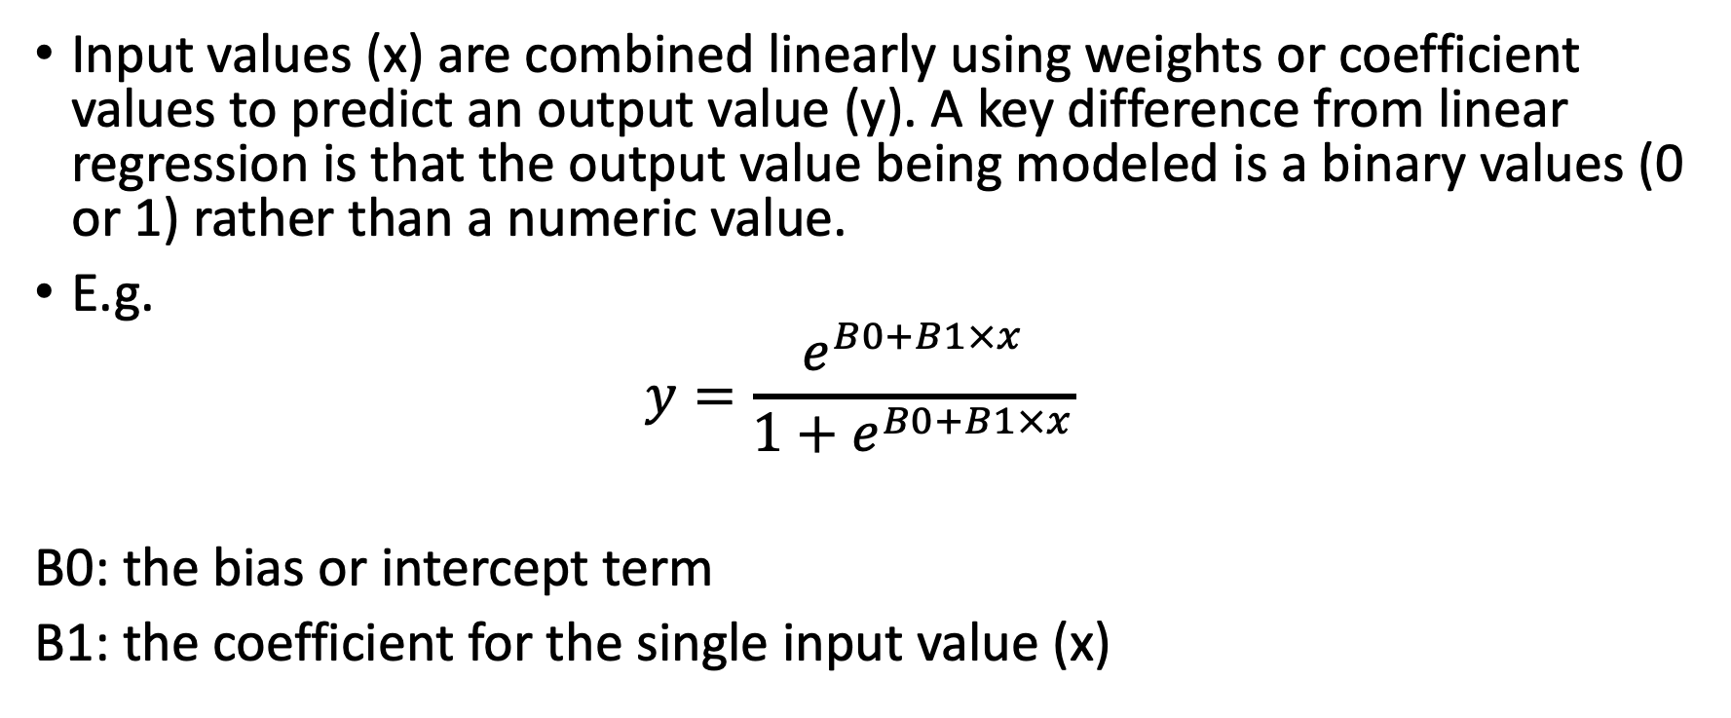
Representation Used for Logistic Regression
Input values (x) are combined linearly using weights or coefficient values to predict an output value (y). A key difference from linear regression is that the output value being modeled is a binary values (0 or 1) rather than a numeric value.
E.g.
$$y=\frac{e^{B0+B1×x}}{1+e^{B0+B1×x}}$$
B0: the bias or intercept term
B1: the coefficient for the single input value (x)

Slide 6
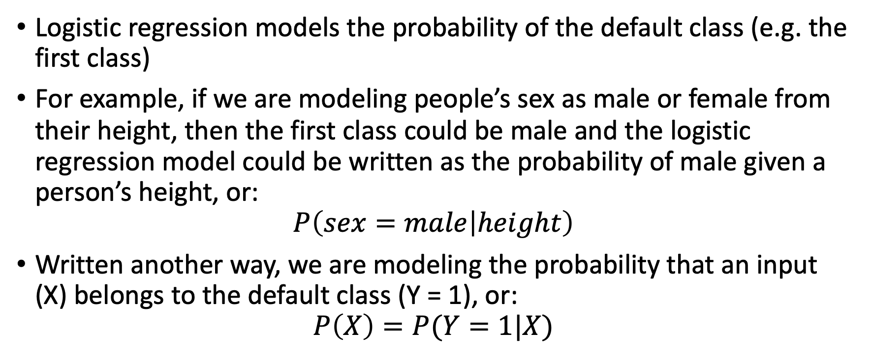
Logistic Regression Predicts Probabilities
Logistic regression models the probability of the default class (e.g. the first class)
For example, if we are modeling people’s sex as male or female from their height, then the first class could be male and the logistic regression model could be written as the probability of male given a person’s height, or:
$$P\left(sex=male | height\right)$$
Written another way, we are modeling the probability that an input (X) belongs to the default class (Y = 1), or:
$$P\left(X\right)=P(Y=1|X)$$

Slide 7
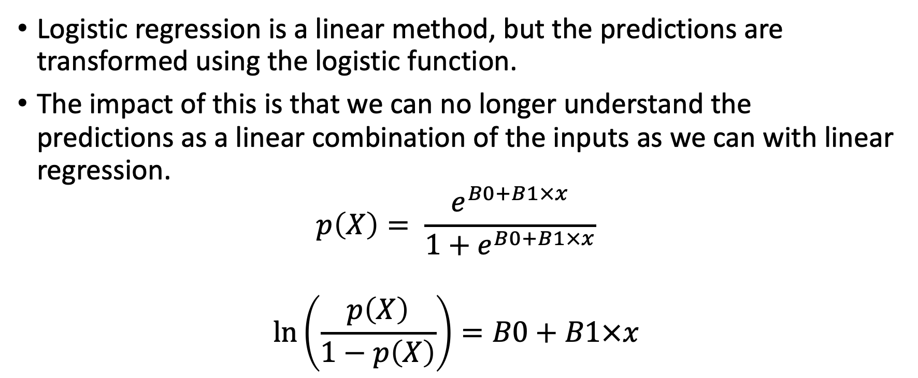
Logistic Regression Predicts Probabilities
Logistic regression is a linear method, but the predictions are transformed using the logistic function.
The impact of this is that we can no longer understand the predictions as a linear combination of the inputs as we can with linear regression.
$$p\left(X\right)= \frac{e^{B0+B1×x}}{1+e^{B0+B1×x}}$$
$$\ln\left(\frac{p\left(X\right)}{1−p\left(X\right)}\right)=B0+B1×x$$

Slide 8
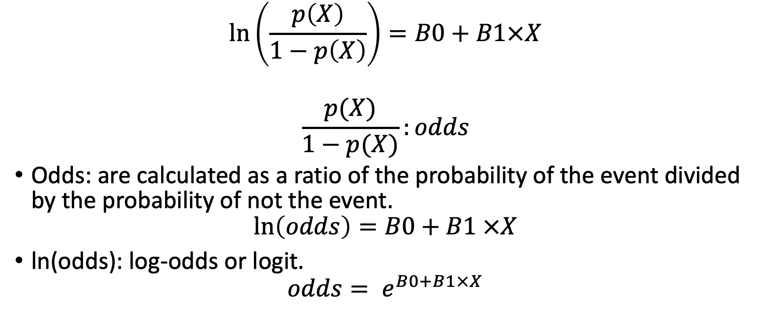
Logistic Regression Predicts Probabilities
$$\ln\left(\frac{p\left(X\right)}{1−p\left(X\right)}\right)=B0+B1×X$$
$$\frac{p(X)}{1−p(X)}:odds$$
Odds: are calculated as a ratio of the probability of the event divided by the probability of not the event.
$$\ln\left(odds\right)=B0+B1 ×X$$
ln(odds): log-odds or logit.
$$odds= e^{B0+B1×X}$$

Slide 9
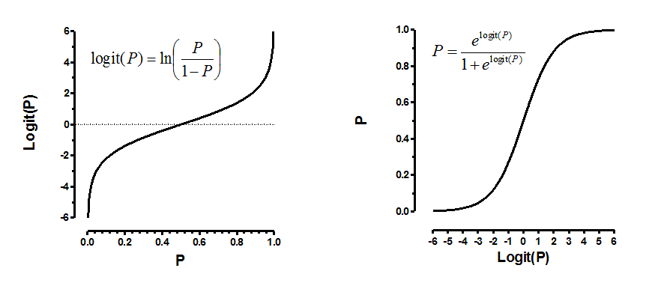
Logit Function
The definition of the function we are trying to optimize to get the estimates of coefficient. This function is analogous to the square of error in linear regression and is known as the likelihood function.

Slide 10
Assumptions of Logistic Regression
The outcome is a binary or dichotomous variable like yes vs no, positive vs negative, 1 vs 0.
There is a linear relationship between the logit of the outcome and each predictor variables. Recall that the logit function is logit(p) = log(p/(1-p)), where p is the probabilities of the outcome.
There is no influential values (extreme values or outliers) in the continuous predictors
There is no high intercorrelations (i.e. multicollinearity) among the predictors.

Slide 11
Important Points
Logistic regression does not assume a linear relationship between dependent and independent variables. However, it assumes a linear relationship between link function and independent variables in logit model.
The dependent variable need not to be normally distributed.
It does not use OLS (Ordinary Least Square) for parameter estimation. Instead, it uses maximum likelihood estimation (MLE).
Errors need to be independent but need to be normally distributed.

Slide 12
Evaluation of Logistic Regression Model
1. AIC (Akaike Information Criteria) – The analogous metric of adjusted R² in logistic regression is AIC. AIC is the measure of fit which penalizes model for the number of model coefficients. Therefore, we always prefer model with minimum AIC value.
2. Null Deviance and Residual Deviance – Null Deviance indicates the response predicted by a model with nothing but an intercept. Lower the value, better the model. Residual deviance indicates the response predicted by a model on adding independent variables. Lower the value, better the model.

Slide 13
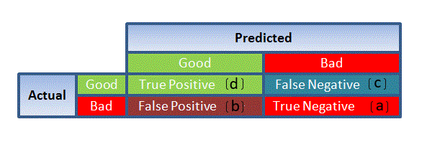
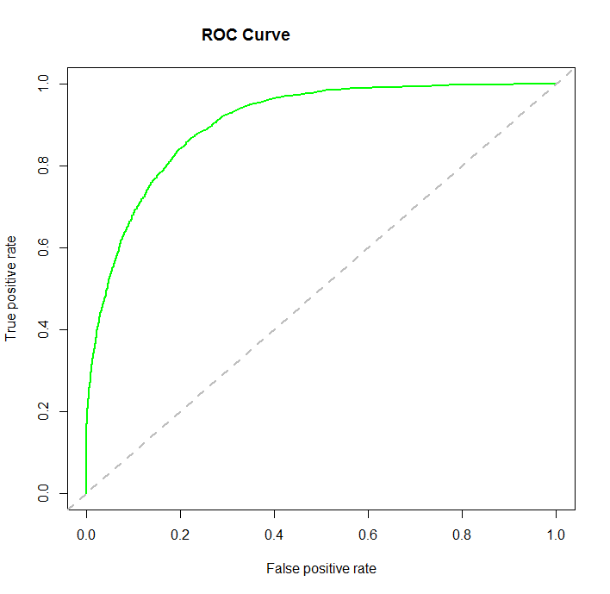
Evaluation of Logistic Regression Model
3. Confusion Matrix: It is nothing but a tabular representation of Actual vs Predicted values. This helps us to find the accuracy of the model and avoid overfitting
4. ROC Curve: ROC summarizes the predictive power for all possible values of p > 0.5.

Slide 14
Logistic Regression Interview Questions
True-False: Is Logistic regression a supervised machine learning algorithm?
True-False: Is Logistic regression mainly used for Regression?
True-False: Is it possible to design a logistic regression algorithm using a Neural Network Algorithm?
True-False: Is it possible to apply a logistic regression algorithm on a 3-class Classification problem?
One of the very good methods to analyze the performance of Logistic Regression is AIC, which is similar to R-Squared in Linear Regression. Which of the following is true about AIC?
A) We prefer a model with minimum AIC value B) We prefer a model with maximum AIC value C) Both but depend on the situation D) None of these

Slide 15
Answer
TRUE
FALSE
True, Neural network is a is a universal approximator so it can implement linear regression algorithm.
Yes, we can apply logistic regression on 3 classification problem, We can use One Vs all method for 3 class classification in logistic regression.
A

